Slide 1
Kernel methods
Dr Kapil
NIT Kurukshetra

Slide 2
Outline
Motivation
General definition
Kernel SVM
Kernel PCA
Spectral Clustering
Kernel as features
Semi-Supervised Manifold regularization of unlabelled data
Kernel LDA
Kernel ridge regression
Kernel ELM
Kernel RVFL

Slide 3
Examples
1-Dimensional Data
Linear classifier
x=0
x=0
Positive “plane”
Negative “plane”

Slide 4
Another Example
What about this set of data points?
Any Classifier?
x=0

Slide 5
Another Example
What about this set of data points?
Any Classifier?
Projection in z = (x, x²)
x²
x= 0
x = 0

Slide 6
Another Example
What about this set of data points?
Any Classifier?
Projection in z = (x, x²)
Projecting the data in higher dimensional space may help
x²
x=0
x=0

Slide 7
Non Linear/Kernel SVM

Slide 8
The Non Linear problem formulation
subject to

Slide 9
Linear Dual formulations
subject to-
Let’s take our input samples to higher dimensional space where the problem maybe linearly separable?

Slide 10
Linear Dual formulations
subject to-

Slide 11
Non linearly separable data points
Instead of finding an non-linear classifier it might be possible to find linear classifier in higher dimensional input space.
So, it might be a good idea to find such a mapping.
How to find such a mapping?

Slide 12
Not so easy
Every Problem is specific, how to identify such mapping

Slide 13
Kernel Trick
Mercer Condition
It says that the dot product in higher dimensional space can be represented by some kernel function.

Slide 14
Kernel Trick
Mercer Condition
It says that the dot product in higher dimensional space can be represented by some kernel function.
Mercer Condition ensures that QPP problem remains convex.
And we can see our dual has input samples coming only in that!
There are a few conditions under which a function qualifies for kernel function.
https://towardsdatascience.com/understanding-support-vector-machine-part-2-kernel-trick-mercers-theorem-e1e6848c6c4d
https://ocw.mit.edu/courses/sloan-school-of-management/15-097-prediction-machine-learning-and-statistics-spring-2012/lecture-notes/MIT15_097S12_lec13.pdf

Slide 15
The Nonlinear Dual with Kernel Trick
subject to-

Slide 16
Some Common Kernels
Examples of commonly-used kernel functions:
Linear kernel:
Polynomial kernel:
Gaussian (Radial-Basis Function (RBF) ) kernel:
Sigmoid:
In general, functions that satisfy Mercer’s condition can be kernel functions.

Slide 17
Nonlinear SVM
Formulation: (Lagrangian Dual Problem)
such that
The solution of the discriminant function is
The optimization technique is the same.

Slide 18
Some Implementation

Slide 19
Kernel functions
Polynomial is inner product in dimensional space.
The mapping it follows
https://ocw.mit.edu/courses/sloan-school-of-management/15-097-prediction-machine-learning-and-statistics-spring-2012/lecture-notes/MIT15_097S12_lec13.pdf

Slide 20
How many items in a multinomial
Each term of the expansion has n things, now anything can be taken any number of times but total selected things exactly should be n.
Therefore the problem is similar to adding d whole numbers (non-negative integers) whose sum should be exactly n.
(d-1+n)!/(d-1)!n!
And if I want to find the number of terms in

Slide 22
Gaussian Kernel gives mapping to infinite dimensional space
What is the kind of mapping it represents?

Slide 23
Non Linear Principal Component Analysis
Unsupervised

Slide 25
Spectral Clustering
Unsupervised

Slide 26
Definition of Clustering
When you have data but no explicit output
You want to group based on the input features only.
Spectral like PCA is unsupervised

Slide 27
Least Squares Method
Regression

Slide 28
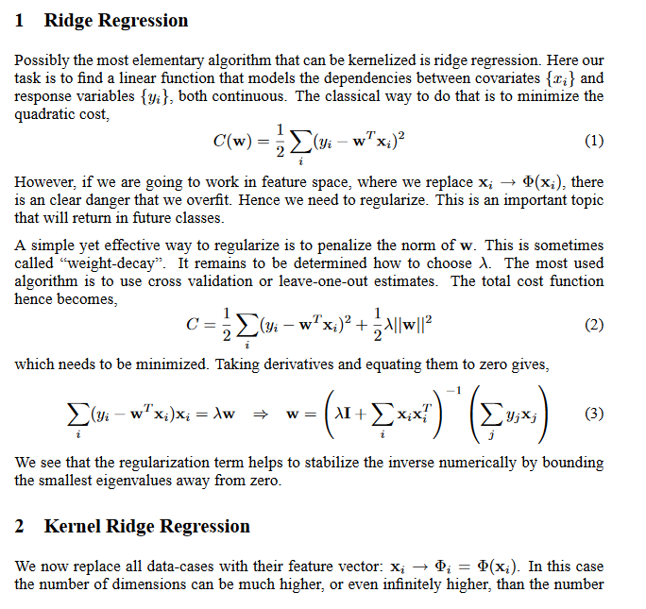

Slide 29
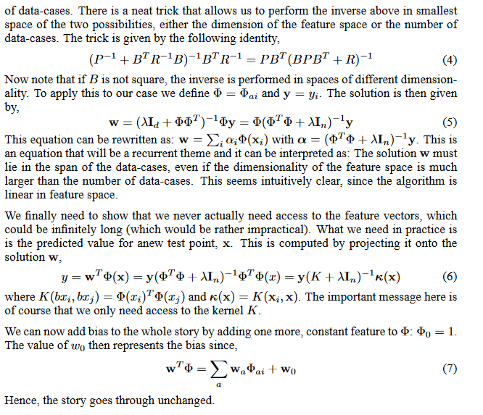
https://www.ics.uci.edu/~welling/classnotes/papers_class/Kernel-Ridge.pdf

Slide 30
Ordinary Least Squares Method (OLS)
The problem is defined as set of data points
Find the function
The objective of the function maybe-
As we may not be able to guess right function but near about it, therefore the function learned f cannot predict y correctly. So let the predicted value is represented by . And now we want
where
and
is function parameter

Slide 31
Here, X is a matrix with each sample is a row.

Slide 32
Reading Material
http://www.cs.cornell.edu/courses/cs4780/2015fa/page4/

